Slide 1
Group 2 Project Presentation

Slide 2
Project Objective
Our goal was to identify trends of food purchases relative to recipe searches, trends in food delivery services and general trends in eating in vs. dining out in the US.
The main questions we wanted to address were:
What are the broad trends in grocery/food store sales vs. restaurant/dining sales during 2020 vs. longer periods of time?
Was there evidence to support these trends on an individual company basis?
Was there any relationship between food at home vs. food away from home?
Was there any relationship between food delivery service data and grocery sale trends?

Slide 3
Sources of Data
USDA
US Census Bureau
SEC public filings
Open Table
Google Trends
COVID Tracking Project
Business of Apps

Slide 4
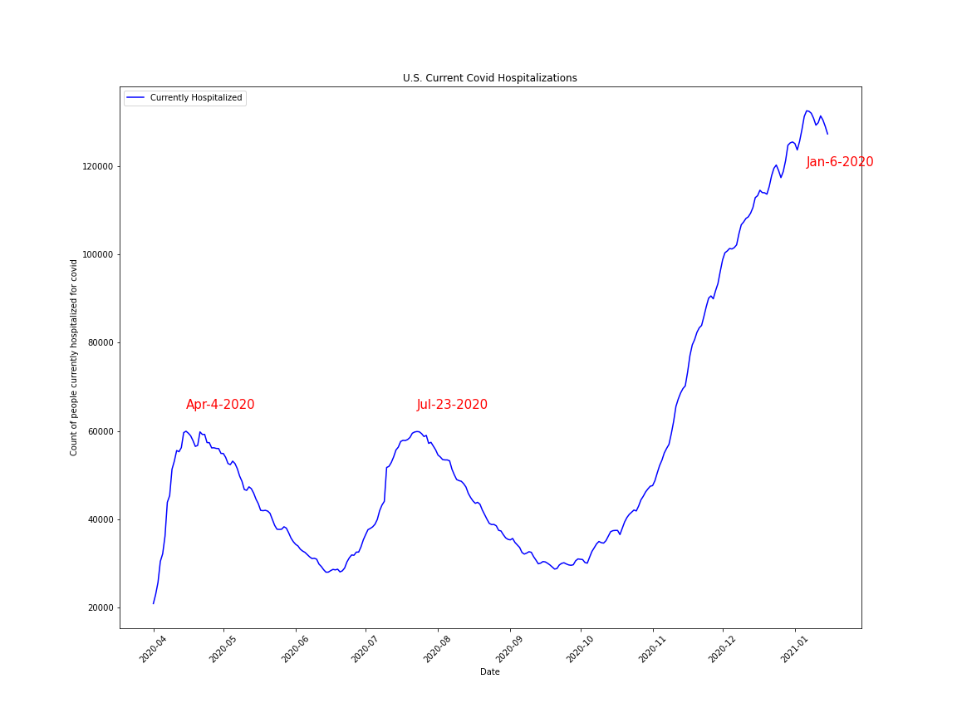
Covid Hospitalization from Covid Tracking Project
Most recent Covid Tracking Project Covid-19 U.S. Current Covid Hospitalizations data was downloaded in .csv form from covidtracking.com
Minimal dataframe cleanup was necessary for the plot
Local maxima were determined using .max() function and .loc
Peak dates of hospitalization were used as a comparison to other data

Slide 5
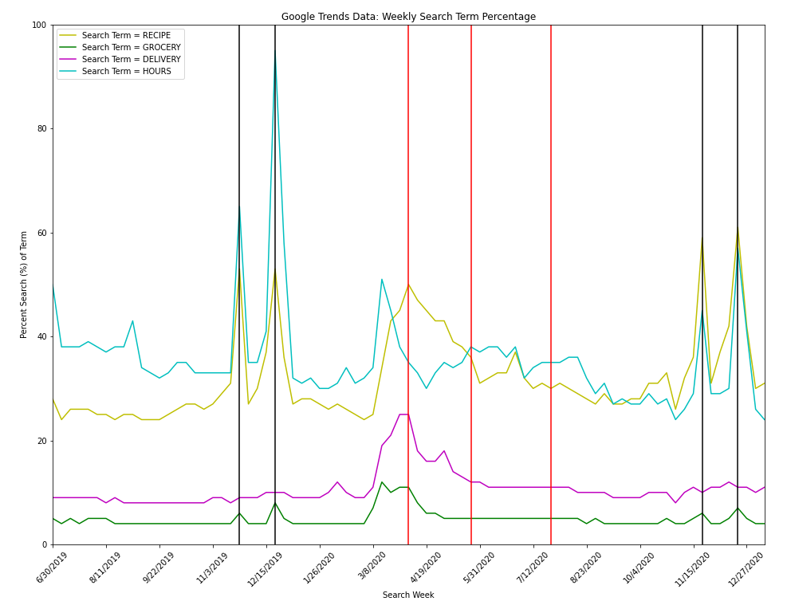
Google Search Trends
Google search trend data is downloadable in .csv form from trends.google.com
Four food/grocery/restaurant related terms were compared in the U.S. for the last 5 yrs: RECIPE, GROCERY, DELIVERY, and HOURS
Data required minimal clean up; two distinct peaks corresponding to approximate date of Thanksgiving and Christmas were visible.
Similar to census data, search terms spiked with onset of pandemic but primarily do not follow hospitalization features.
HOURS shows some additional features, but likely within pre-pandemic baseline.
Indicates Late-July 2nd covid hospitalization maximum
Double peaks correspond to Thanksgiving and Christmas (not seen for DELIVERY)
4/5/2020
5/24/2020

Slide 6
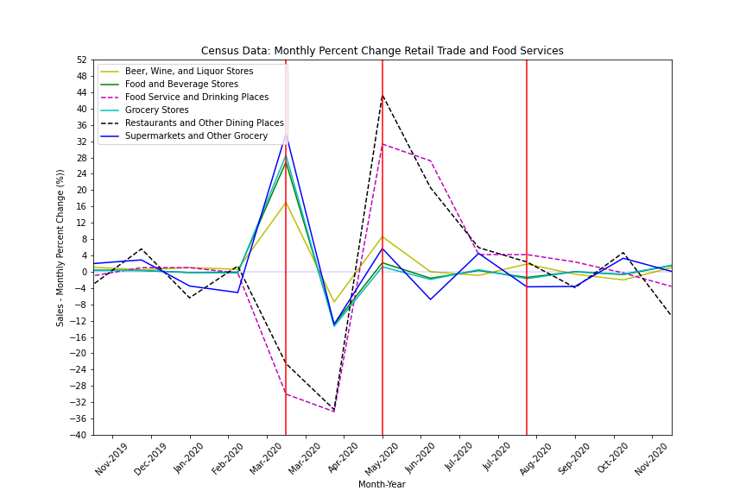
U.S. Monthly Retail Trade and Food Service Data from Census.gov
Census conducts monthly business surveys and data is available at census.gov
Total sales (in millions of dollars) and monthly sales percentage change is available
Multiple data sets were downloaded in .csv form from available time frame (Jan-2017 to Nov-2020)
Clear trend is visible around pandemic onset in the U.S.
Red vertical lines indicate points of interest
Additional hospitalization maxima do not appear to correlate
Indicates Late-July 2nd covid hospitalization maximum
March 2020 sees expected increase and decrease of stores and restaurants, respectively
May 2020 sees rebound of restaurants and food service places

Slide 7
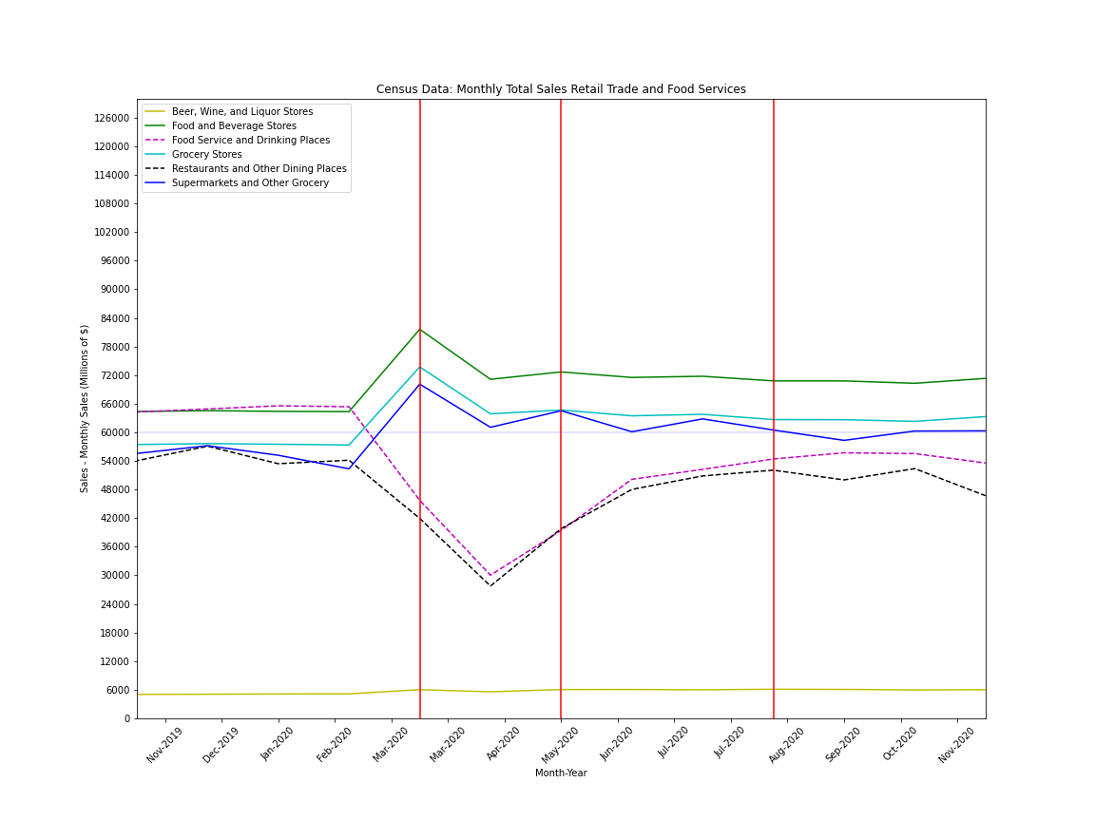
Extra
Monthly total sales in millions of dollars

Slide 8
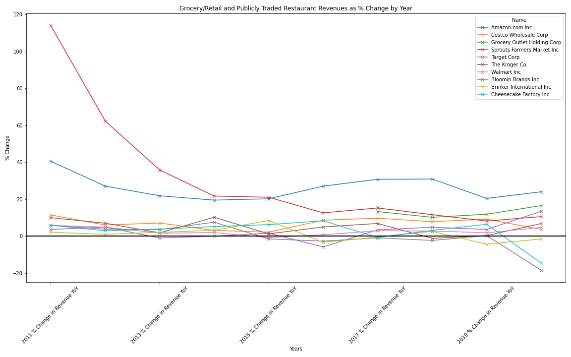
Individual Company Trends
I chose several publicly traded grocery chains (Kroger, Sprouts Farmers Market, Grocery Outlet), large multi-channel retailers (Costco, Target, Walmart) and Amazon, as they acquired Whole Foods several years ago.
I also chose 3 publicly traded restaurant chains, Bloomin Brands (Outback, Carrabba’s, Bone Fish Grill, Fleming’s), Brinker International (Chili’s and Maggiano’s) and Cheesecake Factory.
After compiling the data into a .csv file, I brought the data into a dataframe in pandas and began to clean the formatting.
To estimate full year 2020 revenue data, since most companies have not announced their earnings data yet, I had to make a pro-forma estimate of full year 2020 revenue using TTM revenue numbers and then projecting using Q1 – Q3 revenue numbers which gave me a rough estimate for what Q4 would look like and then rolled all four quarters into an annual estimate for 2020.
After cleaning the revenue data, I made a calculation for the percentage change year over year and created a new dataframe with that information.
Lastly, I plotted the year over year percentage change in revenue to visualize the data graphically, focusing on the divergence between grocers and publicly traded restaurants. As you can see, many of the grocers maintained or actually grew their revenues faster than they had on a trending basis, while the publicly traded restaurant revenues fell off a cliff in 2020.

